Slide 1

Discovery: 6 Years of Blogging
Jian Shuo Wang
wangjianshuo.com
Presented at YLF 2008
Snoqualmie, WA

Slide 2

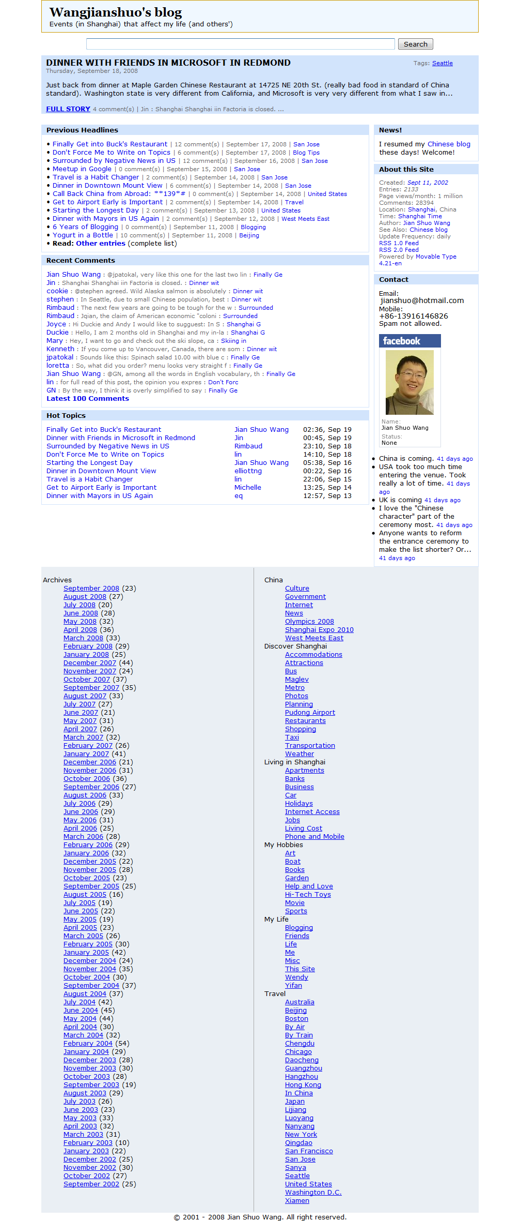

wangjianshuo.com

Slide 3
The Power of Keep Doing and Doing…
Why I started a blog?
  “Why 30 minutes every day?”
  “What did you do in the year of 2007?”
Why I kept blogging?
  Goal is not the motivation. Experience is.
Keep Doing and Doing…
  Balloon hits the Roof Project

Slide 4
Inspiration of Breaking the Limit We Set
“Why not do it?”
Confluence Project – 30N 119E
Personal Photo Exhibition

Slide 5
